Slide 1
Welcome to Arabic Level I by Kurzban

Slide 2

Lesson 8: الدرس الثامن
Objectives:
Review
Quiz
Arabic Alphabet: Two- Way connectors
Practice
Summary
Flash card

Slide 3
Lesson 8: Review
Copy down the following words on you paper several times and remember to proceed from right to left.
جِدار جَريح سَاخِن زُحار

Slide 4
Lesson 8: Review Numbers
Translate the following Arabic Numerals:
سَبعة إثْنان أرْبَعَة
خَمْسَة واحِد تِسْعة
ثَلاثَة تَمَانية سِتّة

Slide 5
Arabic Alphabet: Two-Way Connectors
ف ق ة
The letters (fa) and (qaf)and their sound:
Although the independent shapes of these two letters are different, the shapes in the initial and medial positions resemble each other.
The letter fa is written flashed on the line, where the letter qaf has a bowel like shape and descends below the line.
Let’s try few:
________________ ___________________

Slide 6
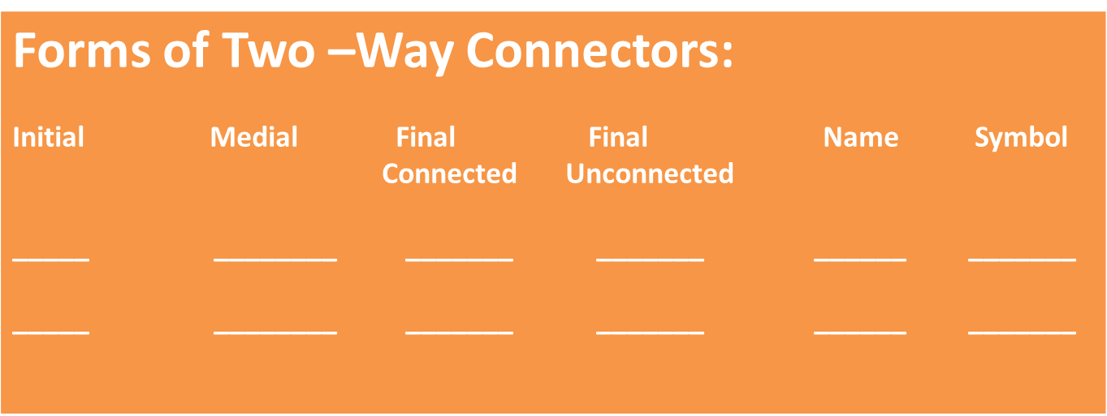
Alphabets: Two-Way Connectors
The sound represented by the letter ق is slightly similar to the K in cot but a little deeper sound. Try cat and cot

Slide 7
Working with fa and qafف and ق
Listen to the following words as you read them, and copy them several times on a ruled sheet of paper:
قَريب خَفيف رَقِيق شُروق

Slide 8
Working with ق and ف
Combine the following letters to form words:
فَ+ ر + ي + د =
فُ + نْ + دُ + ق =
تَ + ق + ا + ر + ي + ر =
Noun (P)
Hotel
Decisions

Slide 9
The Letter ta marbuta and its sound{ة}
The letter ta {ة} is a variant of the regular ta (ت). It serves only as a suffix
The functions it is best known is the feminine marker.
When this letter is attached to most masculine nouns and adjectives, it makes them feminine

Slide 10
Forms of the letter ta marbuta
Following a two way connector:
قرية
Following a one way connector
جريدة

Slide 11
Let’s practice
Combine the letters in each set, including short vowels, to form words
جَ + ر+ي + دَ+ ة + ي=
شَ +ر+ ي +فَ +ة =
ح +ا+ رِ+سَ +ة=
خَ +شَ +ب +ة =

Slide 12
Summary
Identify the letters:
س ، ش، ج، ح، خ، ف، ق، ة
In this excerpt from Arabic newspaper

Slide 13
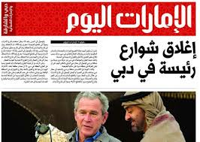
Summary
آخِرُ خَبَر
سَتَبْدَاُ غَداً الأحَدَ أعْمَالُ الدَورةِ التَدرِيبِيَّةِ للإعْلامِ الزِراعيِّ وَ الَّتِي تُقامُ بِرِعايَةِ السيِّدِ خَليل عَرْنُوق
وزيرِ الزِراعَة.

Slide 14

Meaning
Latest news
Will start Sunday's training session for agricultural information, that is run by the Minister of Agriculture Mr. Khalil عرنوق

Slide 15
Mini-Quiz
ثَ +ب + ب +تَ=
ب + يْ +نَ =
=يَ + بُ + ثُ +ث
ب + يْ+ت =

Slide 16
Review
Review
Make your flash card for this lesson
Questions????

